Slide 1
Welcome
Python programming

Slide 2
Introduction to python
Python is a high-level scripting language which can be used for a wide variety of text processing, system administration and internet-related tasks. Unlike many similar languages, its core language is very small and easy to master, while allowing the addition of models to perform a virtually limit less variety of tasks.
Python is a true object-oriented language, and is available on a wide variety of platforms. There’s even a python interpreter written entirely in java, further enhancing python’s position as an excellent for internet-based problems.

Slide 3
Introduction to python
Python was developed in the early 1990’s by Guido van rOSSum, then at cwi in Amsterdam, and currently at cnri in virginia.
In some ways, python grew out of a project to design a computer language which would be easy for beginners to learn, yet would be powerful enough for even advantage users.
This heritages is reflected in python’s small, clean syntax and the thoroughness of the implementation of ideas like object-oriented programming, without eliminating the ability to program in a more traditional style.

Slide 4
Introduction to python
So python is an excellent choice as a first programming language without sacrificing the power and advanced capabilities that users will eventually need.
Al though pictures of snakes often appear on python books and websites, the name is derived from guido van Rossum’s favorite tv show.
Monty python’s flying circus. For this reason, lots of online and print documentation for the language has a light and humorous touch.
Interestingly, many experienced programmers report that python has brought back a lot of the fun they used to have programming .

Slide 5
Introduction to python
So van Rossum’s inspiration may be well expressed in the language itself.
There are few features of python which are different than other programming languages and which should be mentioned early on so that subsequent examples don’t seem confusing.
Further information on all these features will be provided later, when the topics are covered in depth.

Slide 6
Introduction to python
Python statements do not need to end with a special character the python interpreter knows that you are done with an individual statement by the presence of a newline, which will be generated when you press the “return” key of your keyboard.
If a statement spans more than one line the safest course of action is to use a backslash( /) at the end of the line to let python know that you can continue using backslashes on additional continuation lines.

Slide 7
Python basics (python main functions, variables)
Python main function :
Main function is like the entry point of a program. However, python interpreter runs the code right from the first line.
The execution of the code starts from the starting line and goes line by line . It does not matter where the main function is present or it is present or not
Since there is no main() function in python, when the command to run a python program is given to the interpreter, the code that is at level 0 indentation is to be executed.

Slide 8
Python basics (python main functions, variables)
However , before doing that, it will define a few special variables. ____ name ____ is one such special variable.
If the source file is executed as the main program, the interpreter sets the ___ name ___ variable to have a value ___ main ___.
If this file is being imported form another module, ___ name ___ will be set to the module’s name.
___ name ___ is a built-in variable which evaluates to the name of the current module.

Slide 9
Python basics (python main functions, variables)
Example
#python program to demonstrate
#main() function
Print(“hello”)
#defining main function
Def main()
print(“hey there”)

Slide 10
Python basics (python main functions, variables)
#using the special variable
#___ name ___
If ___ name ___==“ ___name___”:
main()

Slide 11
Python basics (python main functions, variables)
Output
Hello
Hey there
When above program is executed, the interpreter declares the initial value of name as “main”.
When the interpreter reaches the if statement it checks for the value of name and when the value of if is true it runs the main function else the main function in not executed.

Slide 12
Python basics (python main functions, variables)
Main function as module
Now when we import a python script as module the ___ name ___ variable gets the value same as the name of the python script imported.

Slide 13
Python basics (python main functions, variables)
Variables
Think of a variable as a name attached to a particular object. In python variables need not be declared or defined in advance, as is the case in many other programming languages.
To create a variable, you just assign it a value and then start using it . Assignment is done with a single equals sign(=):

Slide 14
Python basics (python main functions, variables)
>>> n =300
This is read or interpreted as “ n is assigned the value 300.” once this is done, n can be used in a statement or expression, and its value will be substituted.
>>> print(n)
300
Just as a literal value can be displayed directly from the interpreter prompt in a repl session without the need for a print(), so can a variable.

Slide 15
Python basics (python main functions, variables)
>>> n
300
Later if you change the value of n and use it again, the new value will be substituted instead.
>>> n = 1000
>>> print(n)
1000
>>> n
1000

Slide 16
Python basics (python main functions, variables)
Python also allows chained assignment, which makes it possible to assign the same value to several variables simultaneously.
>>> a = b = c = 300
>>> print(a , b , c)
300 300 300
The chained assignment above assigns 300 to the variables a , b , and c simultaneously.

Slide 17
Python strings
Data types are the classification or categorization of data items. It represents the kind of value that tells what operations can be performed on a particular data.
Since everything is an object in python programming, data types are actually classes and variables are instance(object) of these classes.

Slide 18
Python strings
Standard or build-in data type of python:
Numeric
Sequence type
Boolean
Set
dictionary

Slide 19
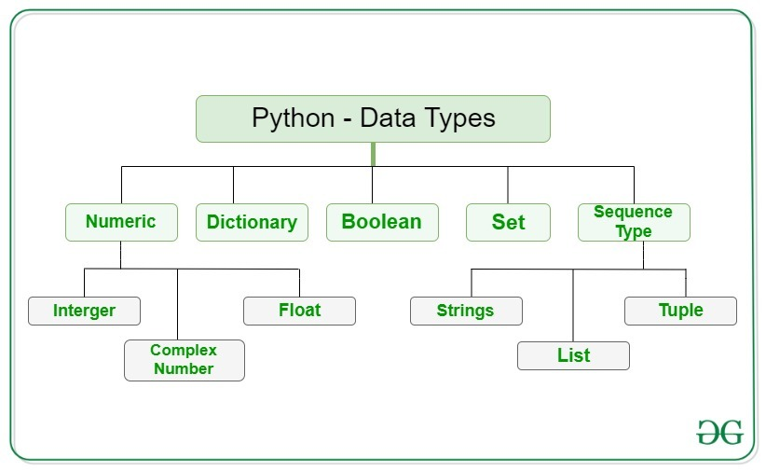
Python strings

Slide 20
Python strings
String
In python strings are arrays of bytes representing Unicode characters. A string is a collection of one or more characters put in a single quote, double-quote or triple quote.
In python there is no character data type, a character is a string of length one it is represented by str class.

Slide 21
Python strings
Accessing elements of string
If python, individual characters of a string can be accessed by using the method of indexing.
Indexing allows negative address references to access characters from the back of the string, example -1 refers to the last character, -2 refers to the second last character and so on.

Slide 22
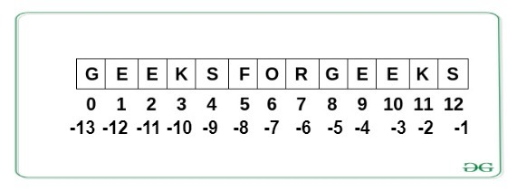
Python strings

Slide 23
Python strings
Deleting and updating from a string
In python updation or deletion of characters from a string is not allowed.
This will cause an error because item assignment or item deletion from a string is not supported .
Although deletion of the entire string is possible with the use of a build – in del keyword.
This is because strings are immutable, hence elements of a string cannot be changed once it has been assigned.

Slide 24
Python strings
Deleting entire string
Deletion of the entire string is possible with the use of del keyword.
Further, if we try to print the string, this will produce an error because string is deleted and is unavailable to be printed.

Slide 25
Python tuple
Python tuples is an immutable collection of that are more like lists. Python provides a couple of methods to work with tuples.
In this article, we will discuss these two methods in detail with the help some emamples.
Count () method
The count() method of tuple returns the number of times the given element appears in the tuple.

Slide 26
Python tuple
Syntax:
Tuple. count(element)
Where the element is the element that is to be counted.
Example 1: using the tuple count() method
Tuple 1 = (0, 1, 2, 3, 2, 3, 1, 3, 2)
Tuple 2 = (‘python’, ‘geek’, ‘python’ , ‘for’, ‘java’, ‘python’)
# count the appearance of 3

Slide 27
Python tuple
Res = tuple 1. count(3)
Print(‘count of 3 in tuple is : ‘,res)
# count the appearance of python
Res = tuple 2 . Count(‘python’)
Print(‘count of python in tuple2 is :’,res)

Slide 28
Python tuple
Output:
Count of 3 in tuple is : 3
Count of python in tuple is : 3
Index () method
The index() method returns the first occurrence of the given element from the tuple

Slide 29
Python tuple
Syntax:
Tuple . index(element, start, end)
Parameters :
Element : the element to be searched.
Start(optional) : the starting index from where the searching is started .
End(optional) : the ending index till where the searching is done.

Slide 30
Python tuple
This method raises a value error if the element is not found in the tuple.
Example : using tuple index()method
#creating tuples
Tuple = (0, 1, 2, 3, 2, 3, 1, 3, 2)
#getting the index of 3
Res = tuple. . Index (3)

Slide 31
Python tuple
Print (‘first occurrence of 3 is’, res)
#getting the index of 3 after 4th
Index
Res = tuple . Index(3,4)
Print(‘first occurrence of 3 after 4th index is :’, res)

Slide 32
Python tuple
Output :
First occurrence of 3 is 3
First occurrence of 3 after 4th index is : 5
Complexities for creating tuples:
Time complexity : 0(1)
Auxiliary space : 0(n)

Slide 33
Python tuple
Accessing of tuples
Tuples are immutable , and usually, they contain a sequence of heterogeneous elements that are accessed via unpacking.
Indexing or even by attribute in the case of named tuples. Lists are mutable, and their elements are usually homogeneous and are accessed by iterating over the list.
In unpacking of tuple number of variables on the left-hand side should be equal to a number of values in given tuple .

Slide 34
Python tuple
Concatenation of tuples
Concatenation of tuple is the process of joining two or more tuples. Concatenation is done by the use of ‘+’ operator.
Concatenation of tuples is done always from the end of the oriqinal tuple.
Other arithmetic operations do note apply on tuples .
Only the same datatype can be combined with concatenation, an error arises if a list and tuple are combined.

Slide 35
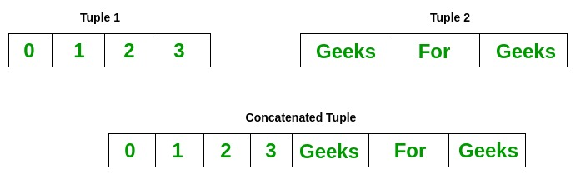
Python tuple

Slide 36
Phyton dictionary
Python dictionary is like a map that is used to store data in the from of a key: value pair .
Python provides various in built functions to deal with dictionaries. In this article, we will see a list of all the functions provided by python to work with dictionaries.
Table of python dictionary methods

Slide 37
Phyton dictionary
Functions name | Description
Clear () | Removes all items from the dictionary
Copy () | Returns a shallow copy of the dictionary
From keys() | Creates a dictionary from the given sequence
Get () | Returns the value for the given key
Items () | Return the list with all dictionary keys with values

Slide 38
Phyton dictionary
Functions name | Description
Keys () | Returns a view object that displays a list of all the keys in the dictionary in order of insertion
Pop () | Returns and removes the element with the given key
Pop item () | Returns and removes the key- vale pair from the dictionary
Setdefault () | Returns the value of a key if the key is in the dictionary else inserts the key with a value to the dictionary
Update () | Updates the dictionary with the elements from another dictionary
Values () | Returns a list of all the values available in a given dictionary .

Slide 39
Phyton dictionary
Dictionary in python is a collection of keys values, used to store data values like a map, which, unlike other data types which hold only a single value as an element .
Example of dictionary in python
Dictionary holds key : value pair. Key – value is provided in the dictionary to make it more optimized .

Slide 40
Phyton dictionary
Dict = {1: ‘geeks’, 2: ‘for’, 3: ‘geeks’}
Print (dict)
Output :
{1: ‘geeks’, 2: ‘for’, 3: ‘geeks’}
Creating a dictionary
In python , a dictionary can be created by placing a sequence of elements within curly {} braces.

Slide 41
Phyton dictionary
Separated by ‘comma’. Dictionary holds pairs of values, one being the key and the other corresponding pair element being its key value.
Values in a dictionary can be of any data type and can be duplicated, where as leys can’t be repeated and must be immutable.
Dictionary keys are case sensitive, the same name but different cases of key will be treated distinctly .
Dictionary can also be created by the built – in function dict ). An empty dictionary can be created by just placing to curly braces{}.

Slide 42
Phyton dictionary
Complexities for creating a dictionary :
Time complexity : 0(len(dict))
Space complexity : 0(n)
Nested dictionary

Slide 43
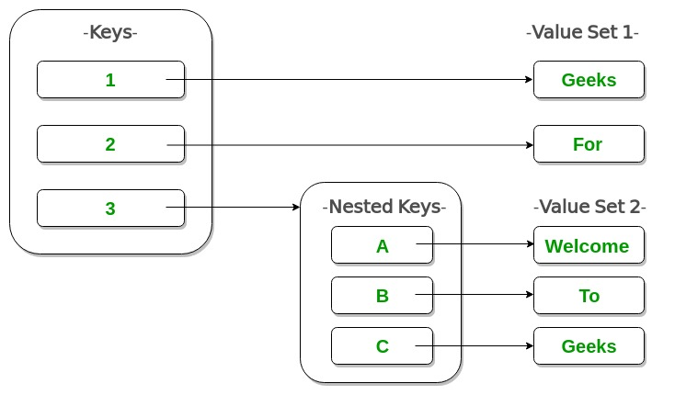
Python dictionary

Slide 44
Python operators
Python operators in general are used to perform operations on values and variables.
These are standard symbols used for the purpose of logical and arithmetic operations.
In this article, we will look into different types of python operators.
Operators : are the special symbols. Example -+, *, /,.
Operand : it is the value on which the operator is applied .

Slide 45
Python operators
Arithmetic operators :
Arithmetic operators are used to performed mathematical operations like addition, subtraction, multiplication, and division.
In python 3.x the result of division is a floating – point while in python 2.x division of 2 integer was an integer and to obtain an integer result in python 3.x floored (// integer) is used .

Slide 46
Python operators
Operator | Description | Syntax
+ | Addition: adds two operands | x + y
- | Subtraction : subtracts two operands | x - y
* | Multiplication : multiplies two | x * y
/ | Division (float) : divides the first operand by the second | X / y
// | Division(floor) : divides the first operand by the second | X // y
% | Modulus : returns the remainder when the first operand is divided by the second | X % y
** | Power : returns first raised to power second | X ** yt

Slide 47
Python operators
Precedence :
P – parentheses
E – exponentiation
M – multiplication (multiplication and have the same precedence)
D - division
A – addition (addition and subtraction have the same precedence)

Slide 48
Python operators
The modulus operator helps us extract the last digit/s of a number. For example .
X % 10 -> yields the last digit
X % 100 -> yield last two digits
Example : arithmetic operators in python
a = 9
B = 4

Slide 49
Python operators
# addition of number
Add = a + b
Sub = a – b
Mul = a * b
Div = a / b
Mod = a % b
P = a ** b

Slide 50
Python operators
# print results
Print(add)
Print(sub0
Print(mul0
Print(sub)
Print(div)
Print(div1) , print (mod), print(p)

Slide 51
Python operators
Output :
13 , 5, 36, 2.25, 2, 1, 6561
Refer to difference between / and // for same interesting facts about these two operators .
Comparison operators :
Comparison of relational operators compares the values. It either returns true or false according to the condition .

Slide 52
Python operators
> | Greater than: True if the left operand is greater than the right | x > y
< | Less than: True if the left operand is less than the right | x < y
== | Equal to: True if both operands are equal | x == y
!= | Not equal to – True if operands are not equal | x != y
>= | Greater than or equal to True if the left operand is greater than or equal to the right | x >= y
<= | Less than or equal to True if the left operand is less than or equal to the right | x <= y
is | x is the same as y | x is y
is not | x is not the same as y | x is not y

Slide 53
Python operators
=is an assignment operator and == comparison operator.
Example : comparison operators in python
a = 13
B = 33
Print(a>b)
Output :
False

Slide 54
Python functions with example
Python functions is a block of statements that returns the specific task.
The idea is to put some commonly or repeatedly done tasks together and make a function so that instead of writing the same code again and again for different inputs, we can do the function calls to reuse code contained in it over and over again.
Syntax : python functions

Slide 55
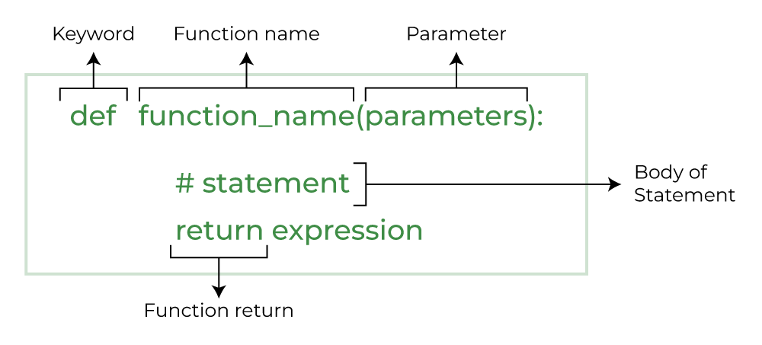
Python functions with example

Slide 56
Python functions with example
Creating a python function
A simple python function
Def fun()
print(“welcome to GITS”)
Calling a python function
After creating a function we can call it by using the name of the function followed by parenthesis containing .

Slide 57
Python functions with example
Parameters of that particular function
Driver code to call a function
Fun()
output: :
Welcome to GITS

Slide 58
Python functions with example
Defining and calling a function with parameters
if you have experience in c/c++ or java then you must be thinking about the return type of the function and data type of arguments. That is possible in python as wee (specifically for python 3.5 and above).
Syntax : python function with parameters

Slide 59
Python functions with example
Def function name (parameter : data _ type) ->return _ type :
“””doctring”””
# body of the function
Return expression
The following example uses arguments that you will learn later in this article so you can come back on it again if not understood.

Slide 60
Python functions with example
It is defined here for people with prior experience in languages like c/c++ of jav
The following are defined using syntax 1, try to convert them in syntax 2 for practice .
Arguments of a python function :
Arguments are the values passed inside the parenthesis of the function.
A function can have any number of arguments separated by a comma.

Slide 61
Python functions with example
In this example , we will create a simple function to check whether the number passed as an argument to the function is even or odd..
Def even odd (x):
If (x % 2 == 0):
Print(“even”)
Else:
Print(“add”)

Slide 62
Python functions with example
Output :
Even odd

Slide 63
Conditional statement(if, else, elif, nested if, switch case statement)
Conditional statement :
Conditional statement in python perform different computations or actions depending on whether a specific boolean constraint evaluates to true or false .
Conditional statements are handled by if statement in python. In this tutorial , we will see how to apply conditional statements in python .

Slide 64
Conditional statement(if, else, elif, nested if, switch case statement)
If statement
The if statement is used for decision-making operations. It contains a body of code which runs only when the condition given in the if statement is true.
If the condition is false, then the optional else statement runs which contains some for the else condition .
When you want to justify one condition while the other condition in nor true, then you use python if else statement .

Slide 65
Conditional statement(if, else, elif, nested if, switch case statement)
If statement syntax :
If expression
statement
Else
statement
Python if else flowchart

Slide 66
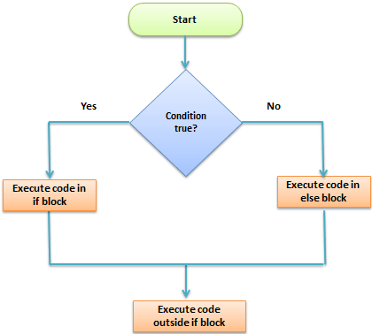
Conditional statement(if, else, elif, nested if, switch case statement)

Slide 67
Conditional statement(if, else, elif, nested if, switch case statement)
Example of if else statement :
Def main():
x , y = 2, 8
if (x < y):
st = “x is less than y”
print(st)
Output : x is less than y

Slide 68
Conditional statement(if, else, elif, nested if, switch case statement)
Else condition :
The “else condation” is usually used when you have to judge one statement on the basis of other.
If one condition goes wrong, then there should be another condition that should justify the statement or logic .
There might be many instances when your “ else condition “ won’t give you the desired result.

Slide 69
Conditional statement(if, else, elif, nested if, switch case statement)
It will print out the wrong result as there is a mistake in program logic. In most cases, this happens when you have to justify more than two statement or condition in a program .
Here both the variables are same (8,8) and the program output is “x is greater than y” , which is wrong.
This is because it checks the first condition (if condition in python), and if fails, then it prints out the second condition (else condition) as default.

Slide 70
Conditional statement(if, else, elif, nested if, switch case statement)
Elif condition :
To correct the previous error made by “ else condition” , we can use “ elif “ statement.
By using “ elsif “ condition , you are telling the program to print out the third condition or possibility when the other condition goes wrong or incorrect.

Slide 71
Conditional statement(if, else, elif, nested if, switch case statement)
Nested If statement :
There come situations in real life when we need to make some decisions and based on these decisions, we decide what should we do next.
Similar situations arise in programming also where we need to make some decisions and based on these decisions we will execute the next block of code.
This is done with the help of decision-making statements in python .

Slide 72
Conditional statement(if, else, elif, nested if, switch case statement)
We can have an if… elif… else statement inside another if… elif… else statement this is called nesting in computer programming.
Any number of these statements can be nested inside one another. Indentation is the only way to figure out the level of nesting.
This can get confusing, so it must be avoided if we can.

Slide 73
Conditional statement(if, else, elif, nested if, switch case statement)
Syntax ;
If(condition 1):
# executes when condition 1 is true
If(condition 2):
# executes when condition 2 in true
# if block is end here
#if block is end here

Slide 74
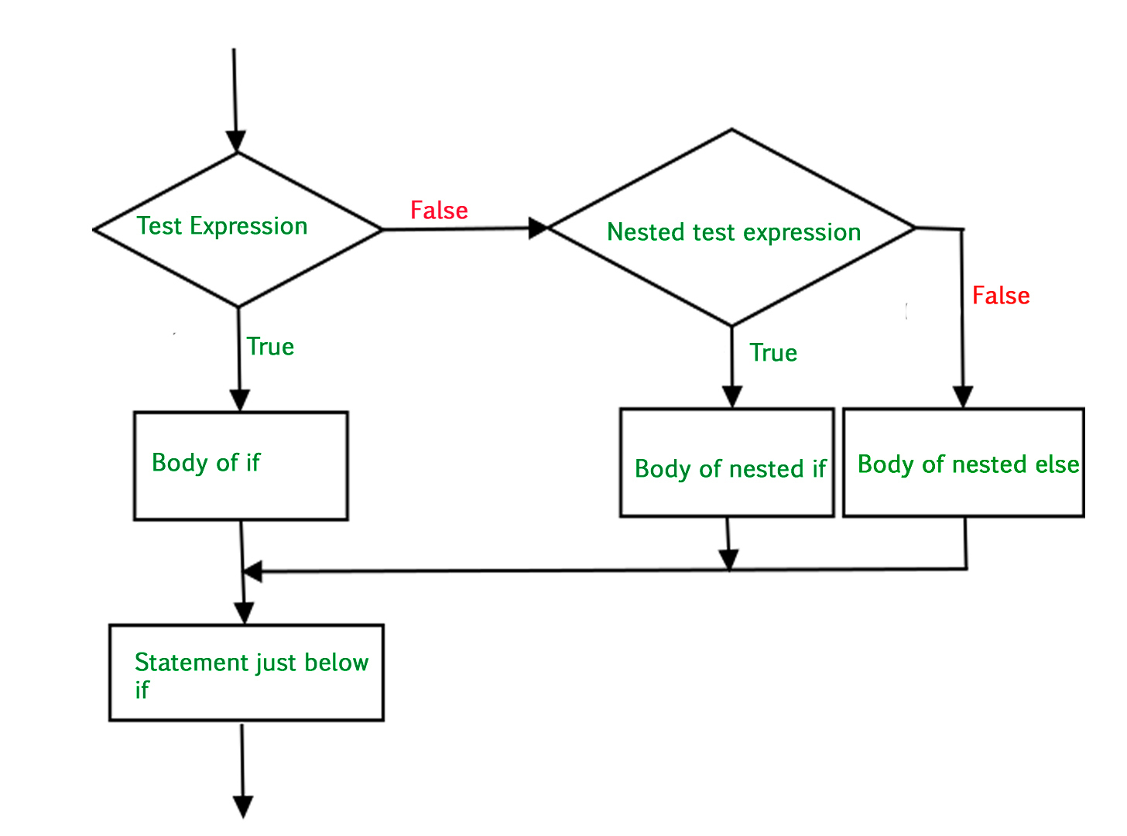
Conditional statement(if, else, elif, nested if, switch case statement)

Slide 75
Conditional statement(if, else, elif, nested if, switch case statement)
Switch case statement :
Unlike every other programming language we have used before, python does not have a switch or case statement .
To get around this fact, we use dictionary mapping.
Method 1: switch case implement in python using dictionary mapping
In python, a dictionary is an unordered collection of data values that can be used to store data values.

Slide 76
Conditional statement(if, else, elif, nested if, switch case statement)
Unlike other data types, which can only include a single value per element, dictionaries can also contain a key: value pair.
The key value of the dictionary data type functions as cases in a switch statement when we use the dictionary to replace the switch case statement.
Def numbers _ to _ strings(argument):
Switcher = {
0 : “zero”, 1: “one”, 2: “two”,
}

Slide 77
Conditional statement(if, else, elif, nested if, switch case statement
Method 2 : switch case implement in python using if else
The if – else is another method to implement switch case replacement . It is used to determine whether a specific statement or block of statements will be performed or not.
Whether a black of statements will be executed if aspecific condition is true or not .

Slide 78
Conditional statement(if, else, elif, nested if, switch case statement
Bike = ‘Yamaha’
If bike == ‘hero; :
Print(“bike is hero”)
Elif bike == “Suzuki” :
Print(“bike is Suzuki”)
Elif bike == ‘Yamaha” :
Else :
Print(“please choose correct answer”)

Slide 79
Conditional statement(if, else, elif, nested if, switch case statement
Output :
Bike is Yamaha
Method 3 : switch case implement in python using class
Int his method, we are using a class to create a switch method inside the python switch class in python .

Slide 80
Looping statement(for & while loops: enumerate, break, continue statement)
Python programming language provides the following types of loops to handle looping requirements.
Python provides three ways for executing the loops. While all the ways provides three ways for executing the loops.
While all the ways provide similar basic functionality , they differ in their syntax and condition checking time.

Slide 81
Looping statement(for & while loops: enumerate, break, continue statement)
While loop in python :
In python a while loop is used to execute a block of statements repeatedly until a given condition is satisfied.
And when the condition becomes false, the line immediately after the loop in the program is executed.
Syntax:

Slide 82
Looping statement(for & while loops: enumerate, break, continue statement)
While expression :
Statement (s)
All the statements indented by the same number of character spaces after a programming construct are considered to be part of a single block of code.
Python uses indentation as its method of grouping statements.
examples: :

Slide 83
Looping statement(for & while loops: enumerate, break, continue statement)
# while loop
Count = 0
While (count < 3):
Count = count + 1
Print(“hello geek”)
Output :
Hello geek hello geek hello geek

Slide 84
Looping statement(for & while loops: enumerate, break, continue statement)
For loop in python
For loops are used for sequential traversal. For example : traversing a list or string or array .
In python, there is no c style for loop for=(i=0;i<n;i++). There is for in loop which is similar to for each loop in other languages.
Let us learn how to use for in loop for sequential traversals.
syntax

Slide 85
Looping statement(for & while loops: enumerate, break, continue statement)
For iterator _ var in sequence :
Statements (s)
It can be used to iterate over a range and iterators .
N = 4
For I in range (0,n)
Print (i)
Output : 0 1 2 3

Slide 86
Looping statement(for & while loops: enumerate, break, continue statement)
Enumerate () in python
Often , when dealing with iterators, we also get need to keep a count of iterations.
Python eases the programmers task by providing a built – in function enumerate () for this task.
Enumerate () method adds a counter to an iterable and returns it in a form of enumerating object.

Slide 87
Looping statement(for & while loops: enumerate, break, continue statement)
This enumerated object can then be used directly for loops or converted into a list of tuples using the list () method.
Syntax :
Enumerate (iterable , start = 0)
Iterable : any object that supports iteration
Start : the index value from which the counter is to be started, by default it is 0.

Slide 88
Looping statement(for & while loops: enumerate, break, continue statement)
Python break statement :
Python break is used to terminate the execution of the loop .
Syntax :
Loop {
Condition :
Break
}

Slide 89
Looping statement(for & while loops: enumerate, break, continue statement)
Break statement in python is used to bring the control out of the loop when some external condition is triggered.
Break statement is put inside the loop body (generally after if condition).
It terminates the current loop, the loop in which it appears, and resumes execution at the next statement immediately after the end of that loop.
If the break statement is inside a nested loop, the break will terminate the innermost loop .

Slide 90
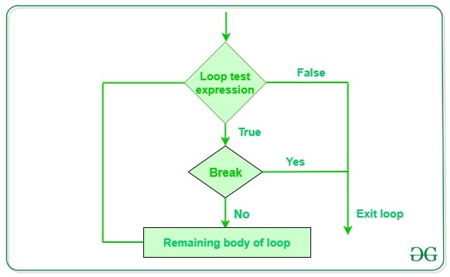
Looping statement(for & while loops: enumerate, break, continue statement)

Slide 91
Looping statement(for & while loops: enumerate, break, continue statement)
Example of python break statement :
For I in range (10):
Print (i)
If I == 2:
Break
Output :
O 1 2

Slide 92
Looping statement(for & while loops: enumerate, break, continue statement)
Continue statement in python :
Python continue statement skips the execution of the program block from after the continue statement and forces the control to start the next iteration .
Is a loop control statement that forces to execute the next iteration of the loop while skipping the rest of the code inside the loop for the current iteration only, the code inside the loop following the continue statement will be skipped for the current iteration and the next iteration of the loop will begin.

Slide 93
Looping statement(for & while loops: enumerate, break, continue statement)
Continue statement syntax :
While true :
…
If x == 10:
Continue
Print (x)

Slide 94
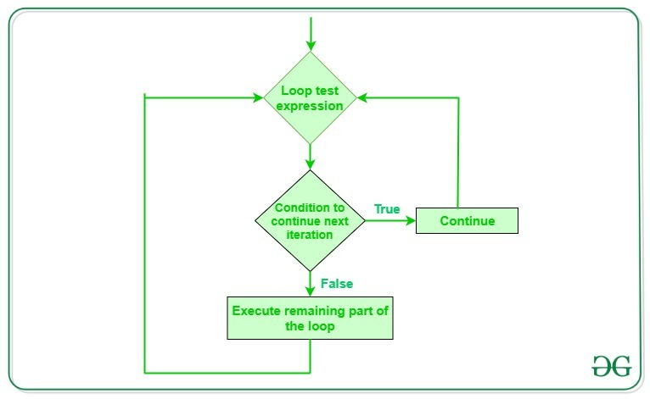
Looping statement(for & while loops: enumerate, break, continue statement)

Slide 95
Python oops : class, object, inheritance, and constructor with example
Python class and objects :
A class is a user – defined blueprint or prototype from which objects are created.
Classes provide a means of bundling data and functionality together. Creating a new class creates a new type of object , allowing new instances of that type to be made.
Each class instance can have attributes attached to it for maintaining its state. Class instances can also have methods (defined by their class) for modifying their state.

Slide 96
Python oops : class, object, inheritance, and constructor with example
To understand the need for creating a class in python let’s consider an example, let’s say you wanted to track the number of dogs that may have different attributes like breed, and age.
If a list is used, the first element could be the dog’s breed while the second element could represent its age.
Let’s suppose there are 100 different dogs , then how would you know which element is supposed to be which what if you wanted to add other properties to these dogs this lacks organization and it’s the exact need for classes.

Slide 97
Python oops : class, object, inheritance, and constructor with example
Syntax : class definition
Class name :
#statement
Syntax : object definition
Obj = class name ()
Print(obj.atrr)

Slide 98
Python oops : class, object, inheritance, and constructor with example
Inheritance in python :
Inheritance is the capability of one class to derive or inherit the properites from another class.
Benefits of inheritance are :
It represents real – world relationships well.
It provides the reusability of a code.
We don’t have to write the same code again and again.

Slide 99
Python oops : class, object, inheritance, and constructor with example
Also , it allows us to add more features to a class without modifying it .
It is transitive in nature , which means that if class binherits from another class a, then all the subclasses of b would automatically inherit from class a.
Python inheritance syntax:
Class base class :
{body}
Class derived class (base class):
{body}

Slide 100
Python oops : class, object, inheritance, and constructor with example
Constructors in python :
Prerequisites : object – oriented programming in python , object – oriented programming in python set 2constructors are generally used for instantiating an object.
The task of constructors is to initialize (assign values) to the data members of the class when an object of the class is created .
In python the _ int _ () method is called the constructor and is always called when an object is created .

Slide 101
Python oops : class, object, inheritance, and constructor with example
Syntax to constructor declaration :
Def __ int __ (self):
#body of the constructor

Slide 102
comparison between python vs java vs php vs Perl vs ruby vs java script vs c ++ vs tcl
Ruby :
Compare to ruby , python has a rich set of data structures , internal functions, beater namespace handling and use of modules and iterators.
Ruby does not support multiple inheritance while python supports multiple inheritance
Python uses while space for handling scopes but ruby uses “end” or”}
Ruby is preferred for web development and functional programming while python for academic and scientific programming.

Slide 103
comparison between python vs java vs php vs Perl vs ruby vs java script vs c ++ vs tcl
Ruby work on “do more with less.” philosophy while python “one right way to do things”.
Java :
Python is more human readable than java
Python has a high – level data types and its dynamic typing programs are shorter than java programs.

Slide 104
comparison between python vs java vs php vs Perl vs ruby vs java script vs c ++ vs tcl
C ++ :
Python code is quite shorter than most other programming languages like c or c ++.
Python is a dynamically typed language, while c ++ is a statically typed language
Python has a large support for built – in functions as compared to c ++

Slide 105
comparison between python vs java vs php vs Perl vs ruby vs java script vs c ++ vs tcl
Php :
Python is more readable while php has more syntax from c/c ++ and perl.
Python is easy to install as compared to php
Python is slow as compared to php
Debugging is easy in python as compared to php
Python supports major gui frameworks.

Slide 106
comparison between python vs java vs php vs Perl vs ruby vs java script vs c ++ vs tcl
Tcl :
Tcl is a week on data structures standalone programming language
Tcl is slow as compared to python .
Perl :
Perl is application oriented while python is object oriented .
Perl supports tasks like report generation, file scanning while python focus on data structures and general programming language .
Python is more readable than perl .

Slide 107
comparison between python vs java vs php vs Perl vs ruby vs java script vs c ++ vs tcl
Java script :
Python is server side . Java script is client side.
Python is extensively used in ai and machine learning while java script lag in this property .
Python uses indentation and whitespace. Java script uses curly brackets to designate blocks of code.

Slide 108

.

